Slide 1
Intel SGX
By dan, ido and daniella

Slide 2
Introduction
Software Guard Extensions (SGX) is a technology, the main function of which is to establish special protected software containers, also known as enclaves.
These enclaves can be used for provisioning sensitive parts of a software executable in order to protect them from malicious entities.
In order to verify remotely that an application is running securely within an enclave, a remote attestation must be performed.

Slide 3
Definitions

Slide 4
Hardware instructions
In order to carry out remote attestation, two hardware instructions are called during the process.
The two instructions are EREPORT and EGETKEY, which are both provided by the Intel SGX Architecture.
EREPORT provides cryptographical structures, also known as REPORTs, special signed structures that bind a key to the hardware (the enclave).
EGETKEY enables the enclave to access the REPORT key used in attestation.
This REPORT key can then be used for verifying REPORTs.

Slide 5
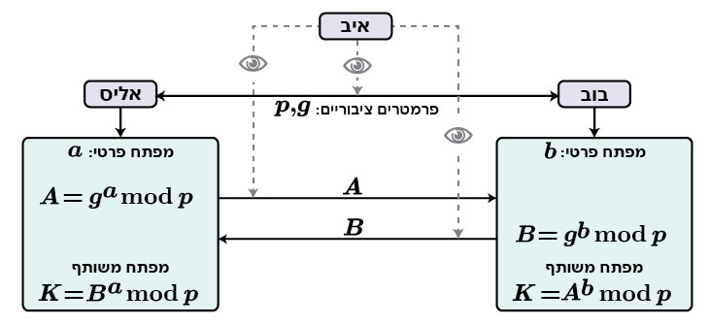
Diffie-Hellmann
Diffie–Hellman key exchange (DHKE) is a method of securely exchanging cryptographic keys over a public channel.

Slide 6
Zero knowledge proof
Zero-knowledge protocol is a method by which one party (the prover) can prove to another party (the verifier) that he knows a value x, without conveying any information apart from the fact that he knows the value x.
A true zero knowledge proof has to meet 2 criteria:
Completeness – The commitment should absolutely convince the verifier that the prover has the correct data.
Soundness – If the prover doesn’t know the correct data, then whatever he does, the verifier should have a very small probability of accepting the proof.

Slide 7
Sigma protocol
Protocols which have the above three-move structure (commitment, challenge and response) are called sigma protocols.
Remote attestation uses Sigma protocol for assisting Diffie-Hellmann key exchange between the client (the application) and the service provider (the challenger).
As a result of this exchange between the client and the service provider, a shared key between the enclave and the challenger is produced that can be used for encrypting secrets that are to be provisioned in the enclave.
Once inside the enclave, these secrets could then be decrypted by the application.

Slide 8
Commitment scheme
is a cryptographic primitive that allows one to commit to a chosen value (or chosen statement) while keeping it hidden to others, with the ability to reveal the committed value later.
Commitment schemes:
– Binding: after the commitment phase, the committer cannot change the value.
– Hiding: the receiver does not know anything about the commitment.

Slide 9
EPID - Intel Enhanced Privacy ID
EPID enables signing objects without leaving a trace that can be uniquely backtracked to the signer, making the signing process anonymous.
This is done by dividing signers to groups (also known as EPID groups), based on their processor type.
This way they create signatures with their own secret keys, but the signatures can be verified only with the public key of the group they belong to, making it possible to check that the signer belongs to the right group, but impossible to uniquely identify the signer.

Slide 10
SigRL - Signature Revocation List
a list of untrustworthy signatures, signed by the revocation authority.
Whenever a signature is determined to be untrustworthy by the revocation authority, the corresponding key is revoked and the signature is placed in the revocation list.

Slide 11
TCB - Intel Trusted Computing Base
an entity responsible for protecting the secrets provisioned to the enclave (both the processor’s hardware and the software running inside the enclave).

Slide 12
Quoting enclave
The quoting enclave is a special enclave on every SQX processor and is tasked entirely with handling the remote attestation.
It receives REPORTs from other enclaves, verifies them and signs them with an asymmetric key before returning the result, also known as a QUOTE, to the application.

Slide 13
Symmetric and asymmetric keys
In symmetric key, encryption key is different from decryption key.
In asymmetric key, encryption key is the same as a decryption key.
In remote attestation, both symmetric and asymmetric key systems are used.
The symmetric key system is used in intra-platform enclave attestation with only the quoting enclave and the EREPORT instruction having access to the authentication key.
Asymmetric key system is used for creating an attestation that can be verified from other platforms (inter-platform attestation).
The attestation key itself is asymmetric.

Slide 14
Local Attestation
Allows an enclave to attest its identity and its TCB to another enclave on the same platform.
In an Intel SGX application, multiple enclaves might collaborate to perform certain functions.
After the two enclaves verify the counterpart is trustworthy, they can exchange information on a protected channel, which typically provides confidentiality, integrity and replay protection.
The local attestation and protected channel establishment uses the REPORT based Diffie-Hellman Key Exchange protocol.

Slide 15
Local Attestation
SGX provides a hardware assertion, REPORT, that contains calling enclaves Attributes, Measurements and User supplied data.
Enclave calls EREPORT instruction to generate REPORT structure for a desired destination enclave
REPORT structure is secured using the REPORT key of the destination enclave
EGETKEY is used by the destination to retrieve REPORT key and then verifies structure using software.

Slide 16
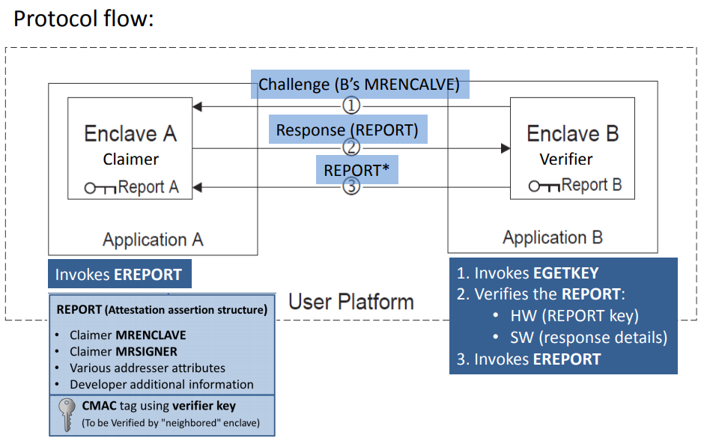
Local attestation

Slide 17
Remote Attestation
An advanced feature of Intel SGX, is the process of proving that an enclave has been established in a secure hardware environment.
This means that a remote party can verify that the right application is running inside an enclave on an Intel SGX enabled platform.
Remote attestation provides verification for three things: the application’s identity, its validity (that it has not been changed by a malicious party), and that it is running securely within an enclave on an Intel SGX enabled platform.
Attestation is necessary in order to make remote access secure, since very often the enclave’s contents may have to be accessed remotely, not from the same platform.

Slide 18
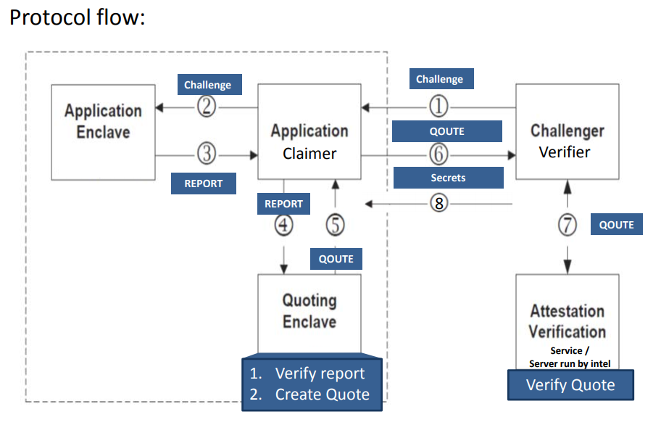
Remote attestation

Slide 19
Initializing the enclave and getting the attestation key
When an enclave is set up (using the EADD/EEXTEND instructions), it takes a measurement of its contents by taking the SHA-256 hash of its memory pages.
An enclave gets a signed attestation for itself from a special Intel enclave called the Quoting Enclave using the local attestation process.
First, the enclave requests a local attestation report using the EREPORT instruction.
The CPU computes an AES128-CMAC (‏keyed hash function that is based on a symmetric key block cipher‏) tag on the enclave's measurement and certificate to create the report.
The Quoting Enclave checks the MAC on the report and replaces it with a signature using the CPU's Attestation Key.

Slide 20
The stages of attestation

Slide 21
First stage
The attestation process begins with the application establishing a communication with the challenger – an entity that wishes to validate whether the application is running securely within the enclaves (The challenger must be located remotely).
Firstly, after a communication is established by the application between the platform and the service providing system, the application asks the challenger to provision secrets.
The challenger then replies by sending an attestation request to the application.

Slide 22
Second stage
Every application is linked to its quoting enclave by storing its Enclave Identity (a cryptographic hash of the enclave’s log).
In this stage, the application sends the challenge and the enclave identity to the application enclave.
The application performing ECALL (a call to the enclave) to initialize the remote attestation by executing sgx_ra_init().
This function takes the challenger’s public key as an argument and creates a context for the Diffie-Hellmann key exchange (DHKE)
the enclave returns a response to the application, and with it, the DHKE context.

Slide 23
Second stage
If the response from sgx_ra_init() was positive, the application calls sgx_get_extended_epid_group_id(), a method for getting the Extended Group ID (also known as Extended GID) of the Intel Enhanced Privacy ID (referred to as EPID)
The application then sends a message (msg0) back to the challenger, containing the Extended GID.
Once the challenger receives the Extended GID, it has the option to verify whether it is legal and whether to commence the attestation or to halt the process
For example, in the case of Intel Attestation Service, only the Extended GID value 0 is considered legal

Slide 24
Third stage
In the application enclave, an ephemeral public key is generated - one that only lasts for a short period of time.
This key is to be used by the challenger for provisioning secrets to the enclave.
The enclave also generates a response to the challenger.
The response and the ephemeral public key are tied together into a manifest and a hash digest is created of the combined key and response manifest, which is then sent back to the application in the form of a REPORT by calling EREPORT

Slide 25
Third stage
Upon getting a green light from the challenger to proceed with the attestation, the application calls the method sgx_ra_get_msg1(), which takes as parameters the application’s public key for the DHKE, the DHKE context found previously, and a pointer to the stub function sgx_ra_get_ga(), which computes the application-side DHKE secret.
The application then sends a message (msg1) consisting of the aforementioned data to the challenger.
Having received the previous message from the application, the challenger checks the values contained in the request and generates its own DHKE parameter.
After that, the challenger queries the IAS for a Signature Revocation List (SigRL). The challenger’s public key and SigRL data are combined together and sent to the application

Slide 26
Fourth stage
In the fourth stage, the application simply receives the REPORT, which included information about the key and its originating enclave, and forwards it to the quoting enclave to be signed

Slide 27
Fifth stage
The quoting enclave receives the REPORT and calls the hardware instruction EGETKEY to get its REPORT key.
Using this REPORT key, the quoting enclave verifies the REPORT.
After that, a QUOTE structure is created and signed by the quoting enclave, using its EPID key, making it only verifiable by IAS(QUOTE in itself is merely a signed REPORT).
Finally, the quoting enclave sends the signed QUOTE to the application

Slide 28
Sixth stage
In this stage, the application receives the QUOTE produced and signed by the quoting enclave, and forwards it back to the challenger.
In detail, the application calls the function sgx_ra_get_msg3_trusted().
This function’s tasks are verifying the challenger’s signature, checking the SigRL provided by the challenger, and generating a reply (msg3) to the challenger.
The reply message will include the QUOTE that was produced by the quoting enclave( It will also include information about aforementioned PSE that may be used on the platform).
This stage ends with the application sending msg3 to the challenger.

Slide 29
Seventh stage
In the final stage, the challenger uses the EPID public key certificate to validate the signature over the QUOTE.
Message-wise, the challenger receives that message msg3 sent by the application in stage 6, and proceeds to check any parameters contained in the message, such as the DHKE parameters and the application enclave’s identity (embedded in the QUOTE).
After a successful check, the challenger forwards the QUOTE and the signature to the IAS to be properly verified.
Once the IAS has verified the QUOTE and the challenger has received the verification results from IAS, the challenger generates a reply message (msg4) to the application.
This message contains the attestation result and optionally (only if both the enclave and PSE are trusted by IAS) the secret that is to be provisioned within the now trusted enclave and can be encrypted by the shared key obtained during the DHKE phase earlier.

Slide 30
Attestation requirements
First of all, Intel Trusted Computing Base (TCB) must be represented by a special platform attestation key, which has to be provided.
Secondly, In case of an upgrade is made to the platform, the attestation key must be replaced.
Thirdly, unsafe parts must have no access to additional attestation keys.
And lastly, the attestation process must guarantee user privacy – that it would be impossible to uniquely identify who created the signature.

Slide 31
The creation of attestation keys
Creating an attestation key representing the hardware and software TCB of Intel SGX consists of two stages
one stands for updating the processor hardware
the other stands for linking the software components of TBC and the hardware TBC key

Slide 32
Replacing attestation keys
After a TCB upgrade, a new attestation key is requested.
The platform is only allowed to join a new EPID group once it has been determined that none of the keys issued to that platform earlier have been revoked.
If none have been revoked, the platform is assigned to a new EPID group

Slide 33
Preventing compromised entities from accessing additional attestation keys
Compromised platforms (processors) are prevented from gaining access to additional attestation keys by applying the current revocation list before issuing new keys.
If an attestation key had been assigned to that platform before, but has been revoked, then the process fails

Slide 34
User privacy guarantee
User privacy is guaranteed by using Intel Enhanced Privacy ID, also known as EPID.
With EPID, it is possible to sign objects (such as QUOTE) without identifying the platform or linking different signatures.
No signer has their own public key, instead signers are divided into groups and the group’s public key is used for verifying signatures.
This prevents from uniquely identifying the real signer, only the group it belongs to

